Slide 1
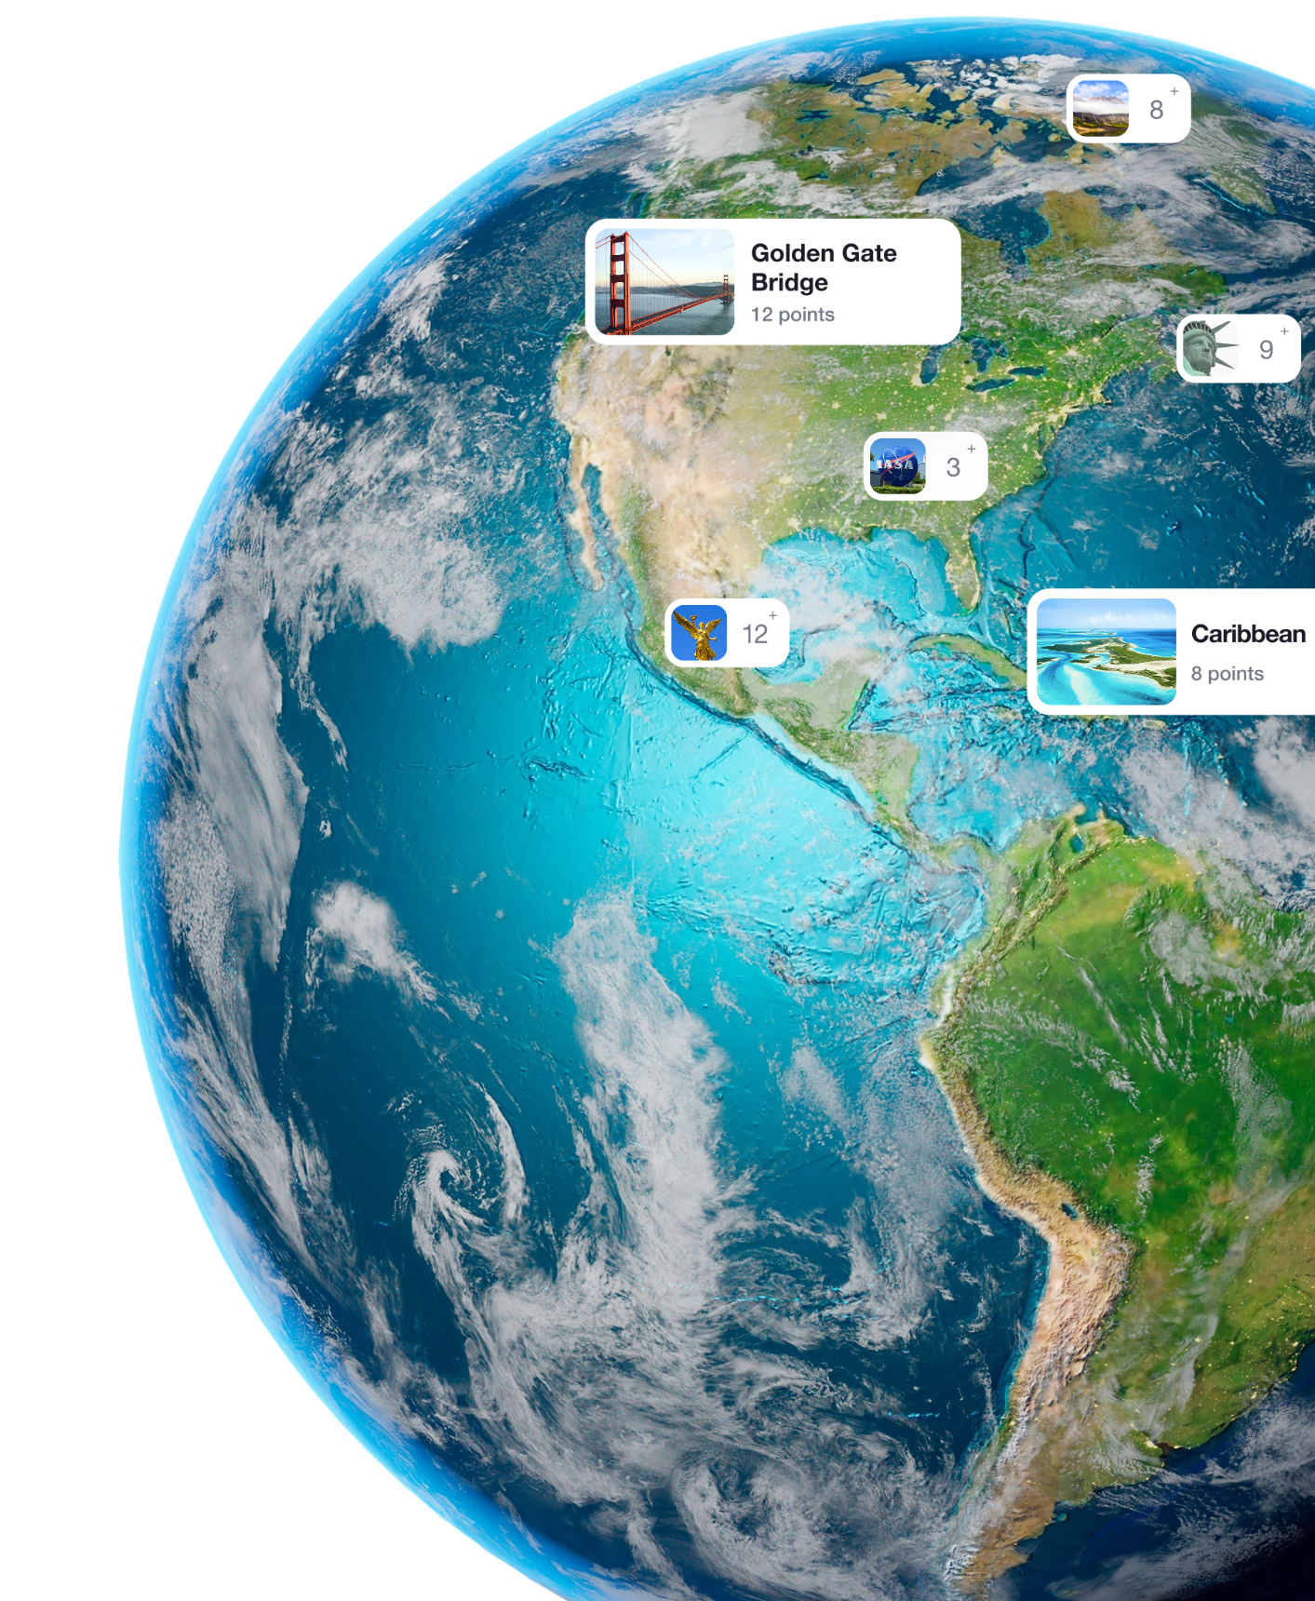


WELCOME TO
TRAVELVERSE
Web3 and AI platform for sustainable visitor flow management

Slide 2

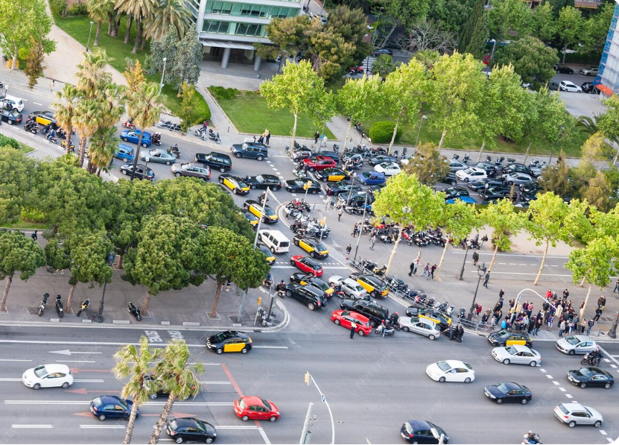
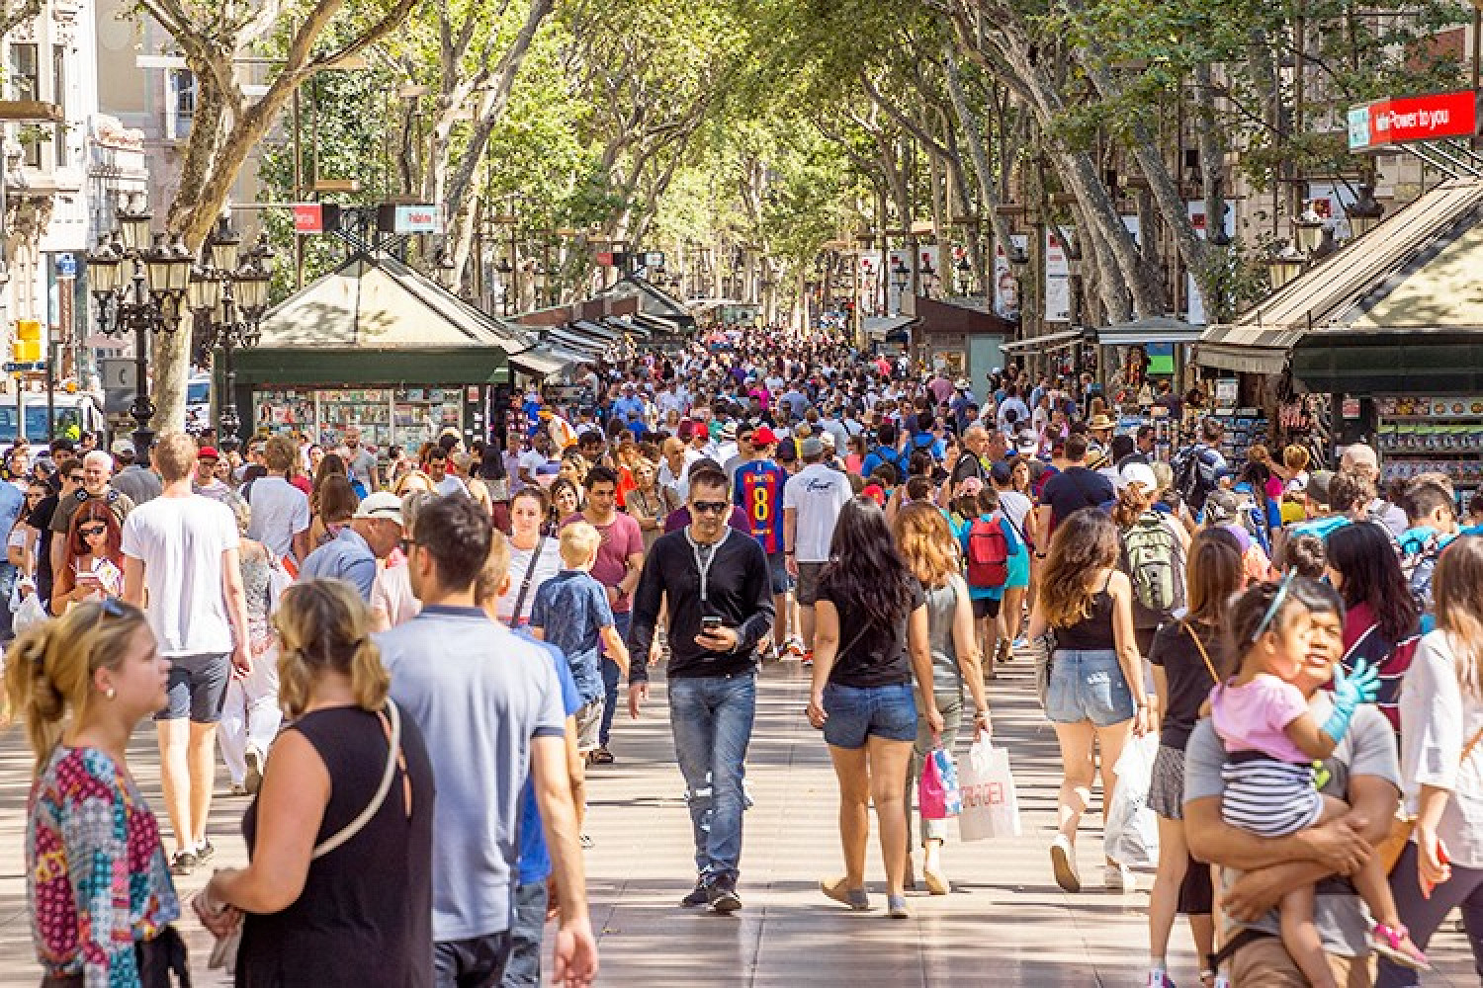
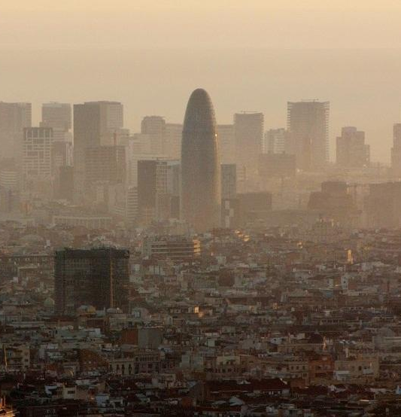
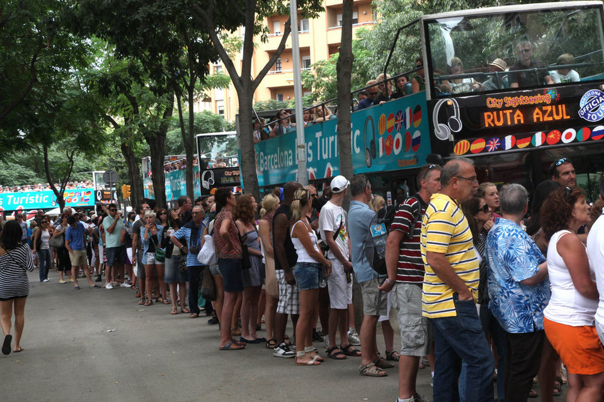
Problem: OVERTOURISM
Initiatives by National Tourism, Cultural Heritage, and Local Government Authorities
Tourism keeps rising despite all existing measures: 11.3M visitors in August 2025 alone – Euronews / INE;
Rental growth (+25%) massively outpaces housing capacity, pushing locals out – Reuters / Exceltur;
By 2040, Spain is expected to face 110M tourists a year — far beyond what current infrastructure can handle – Deloitte (Travelers & Destinations NextGen)
∼5.6 million monthly arrivals expected in 2026 – Trading Economics
Strain on local infrastructure
Unhappy locals &
Loss of authenticity
Environmental degradation
Poor visitor experience
Reduce peak-zone pressure by 20–30% using redistribution logic + incentives
We need a smarter system to guide travelers

Slide 3




TRAVELVERSE ECOSYSTEM
TravelVerse is an open platform that uses AI and Web3 to coordinate visitor flows, provide dynamic routing, and support local cultural infrastructure.
Guided by an AI assistant, each stop unlocks digital collectibles, stories, and rewards that are redeemable locally and globally through NFTs.
Coordination layer
Travelers
AI
Businesses
Creators
Municipalities
Web3
One stage for all players

Slide 4
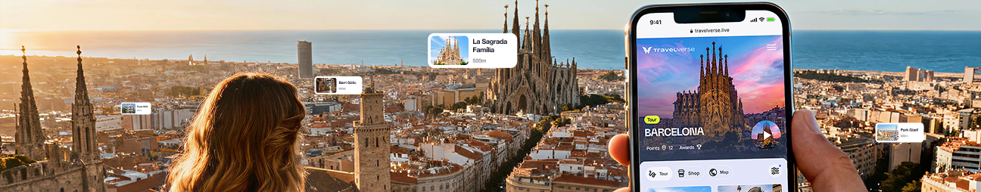
Overview of what has been done
Hackathon
Done Before
Predictive Model (AI)
Incentives / Loyalty
Tourists distribution
Tour distribution
Scalability across destinations
User Experience

Slide 5


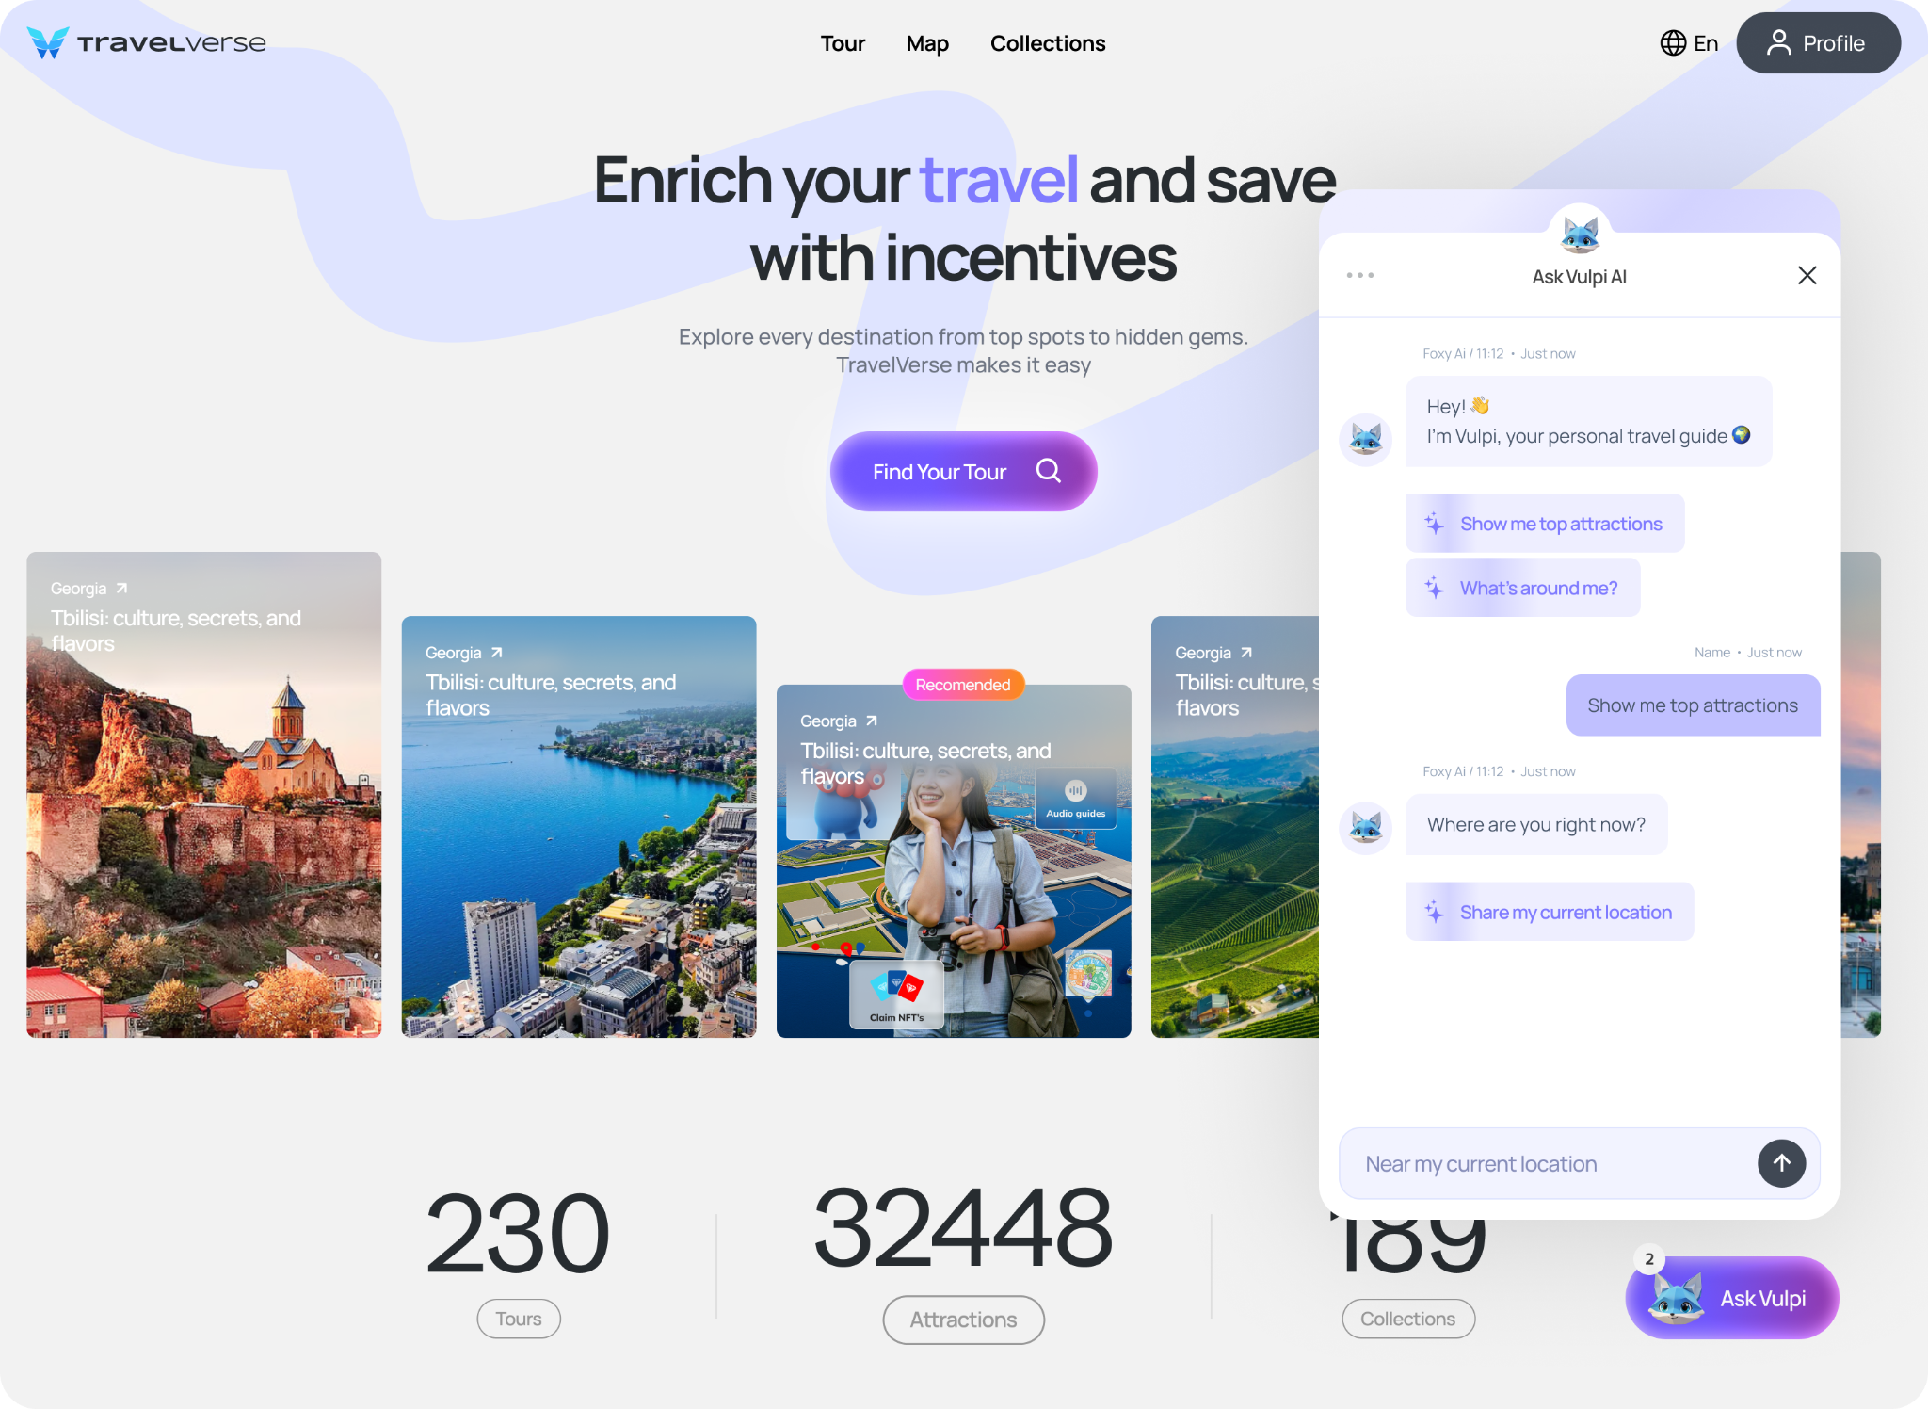

VULPI AI: Transforming the Travel
Smart Routing
Personalization

Slide 6


OVERTOURISM: DATA LAYERS
Travelers Individual and aggregated data on movement patterns, behaviors, and preferences.
Policies from Government and Business Structures Quotas, restrictions, business rules, and regulatory standards.
External Factors Weather changes, public events, traffic conditions, major events, economic and political changes, force majeure situations, seasonality, and global trends.
These data layers enable transparent, evidence-based redistribution of tourist flows
© TravelVerse Copyright. 2025

Slide 7



TravelVerse AI Tools
Routing: up‑to‑date updates on points of interest, user distribution, destination scalability, real‑time traffic information (TBD) Fast processing: selection of POIs based on basic information from the user and the municipality
Matching: consolidation of multi-source parameters and context-aware results

Slide 8
SYSTEM ARCHITECTURE OVERVIEW
From the user’s perspective, the process feels simple: you express what you want, and the system makes sense of it.
User Input Acquisition: Conversational interface (AI Assistant) gathers user preferences and requirements via natural language dialogue.
1
Semantic Data Transformation: LLM parses and encodes user responses into structured vector representations for processing.
2
Contextual Attribute Matching: Backend engine performs similarity matching between user-derived vectors and geolocated attribute datasets stored in the system database.
3
Optimized Recommendation Generation: The system outputs a ranked list of contextually relevant and sustainable destination options, tailored to user input and current load conditions.
4
© TravelVerse Copyright. 2025

Slide 9


CROWD SCORE: LOGIC & WEIGHT TYPES
We take the raw traffic data for the POI:
Current traffic: 60%
Maximum traffic today: 80%
Crowd rank for today: 3 (1 = very calm, 7 = very busy)
Adjustment based on the user’s preference
Avoids crowds → Score = 26
Enjoys lively places → Score = 74
Neutral preference → Score = 78
AI identifies how much “headroom” remains before the location reaches its peak congestion and estimates a small increase, resulting in a combined expected crowd level of 74%.
The adjusted 0–100 result is then multiplied by the crowd weight within the main decision formula.
Behind this calculation are three types of weights that shape the final output:
Formulas – convert raw data into meaningful signals
Coefficients – scale the influence of each factor
Business Rules – enforce fixed logic or overrides
The result (0–100) is then multiplied by the crowd weight inside the main formula
© TravelVerse Copyright. 2025

Slide 10


TRANSPARENT WEB3 LAYER
Blockchain ensures transparency: locations cannot pay to be recommended
Tokenized Proof-of-Visit (NFT or digital ID)
Transparent visit log (no personal data stored)
Reward mechanism:
for visiting less-crowded locations
for environmentally responsible behavior
Integration with local operators and businesses
© TravelVerse Copyright. 2025

Slide 11

COEFFICIENT-BASED DECISION LOGIC
Each user response generates points and coefficients that represent their current state and preferences.
EXAMPLE QUESTIONS:
“Are you tired?” → affects energy level coefficient
“Do you want to eat?” → affects food interest coefficient
“Do you need an elevator?” → affects accessibility coefficient
User responses → aggregated into a user coefficient vector.
Each location has a coefficient profile (accessibility, activity, crowd density, etc.).
Algorithm calculates proximity between user and location vectors.
Highest weighted similarity score locations are recommended, ensuring tailored and context-aware suggestions.
© TravelVerse Copyright. 2025

Slide 12
CATEGORISING METHODS
Goal: Use category-based intent mapping to steer visitors away from overcrowded spots and distribute footfall across the city.
CORE CATEGORIES (USER-FACING):
Heritage – Triggered when users express interest in history
Nature – Triggered by interest in natural environments
Experiences – Triggered by interest in interactive activities
Hospitality – Triggered by interest in food
Wellness – Triggered by interest in relaxation
Category affinity = user intent vector × location attribute vector.
Crowd-pressure penalty reduces scores for overloaded areas.
© TravelVerse Copyright. 2025

Slide 13

KEY TECHNOLOGIES
LLM-based natural language understanding
Real-time data API integration
Scalable Cloud Infrastructure
Semantic data modeling and vector comparison
Dynamic ranking algorithms
Multi-language & Localization Support
Integration with Urban Mobility & Event Systems
Data Privacy & Security
The tech simply makes that harmony possible at scale
© TravelVerse Copyright. 2025

Slide 14

EXAMPLE SCENARIO
User: tired, wants to eat, prefers to avoid crowds.
AI: records the corresponding coefficients (tired ↑, food interest ↑, crowd-avoidance ↑).
External data:
city center is overcrowded,
peripheral areas have low visitor density,
weather conditions are normal.
Output: recommendations generated based on the combined coefficient profile
Result demonstrates behavior-aligned redistribution
Good food, good timing, good experience
© TravelVerse Copyright. 2025

Slide 15






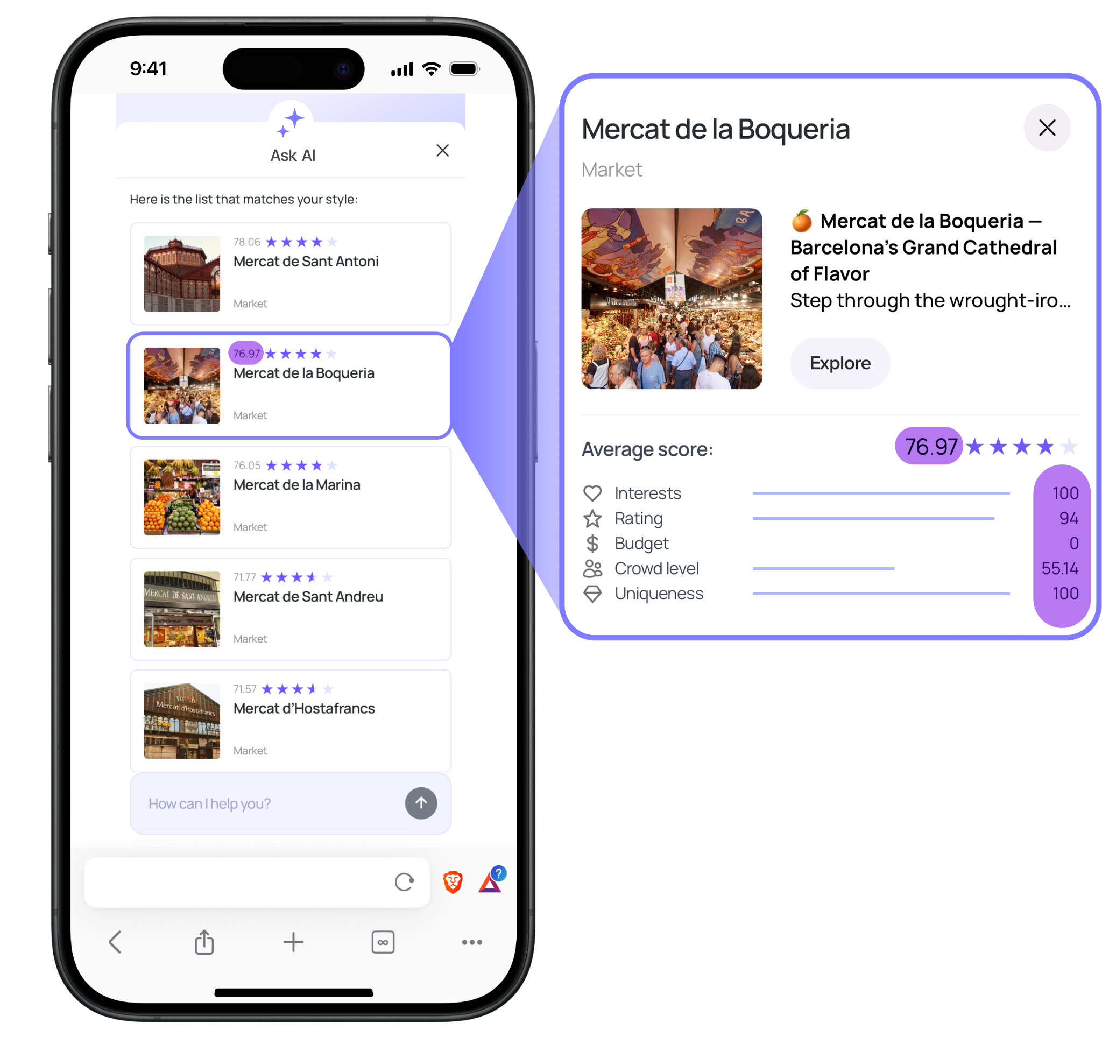
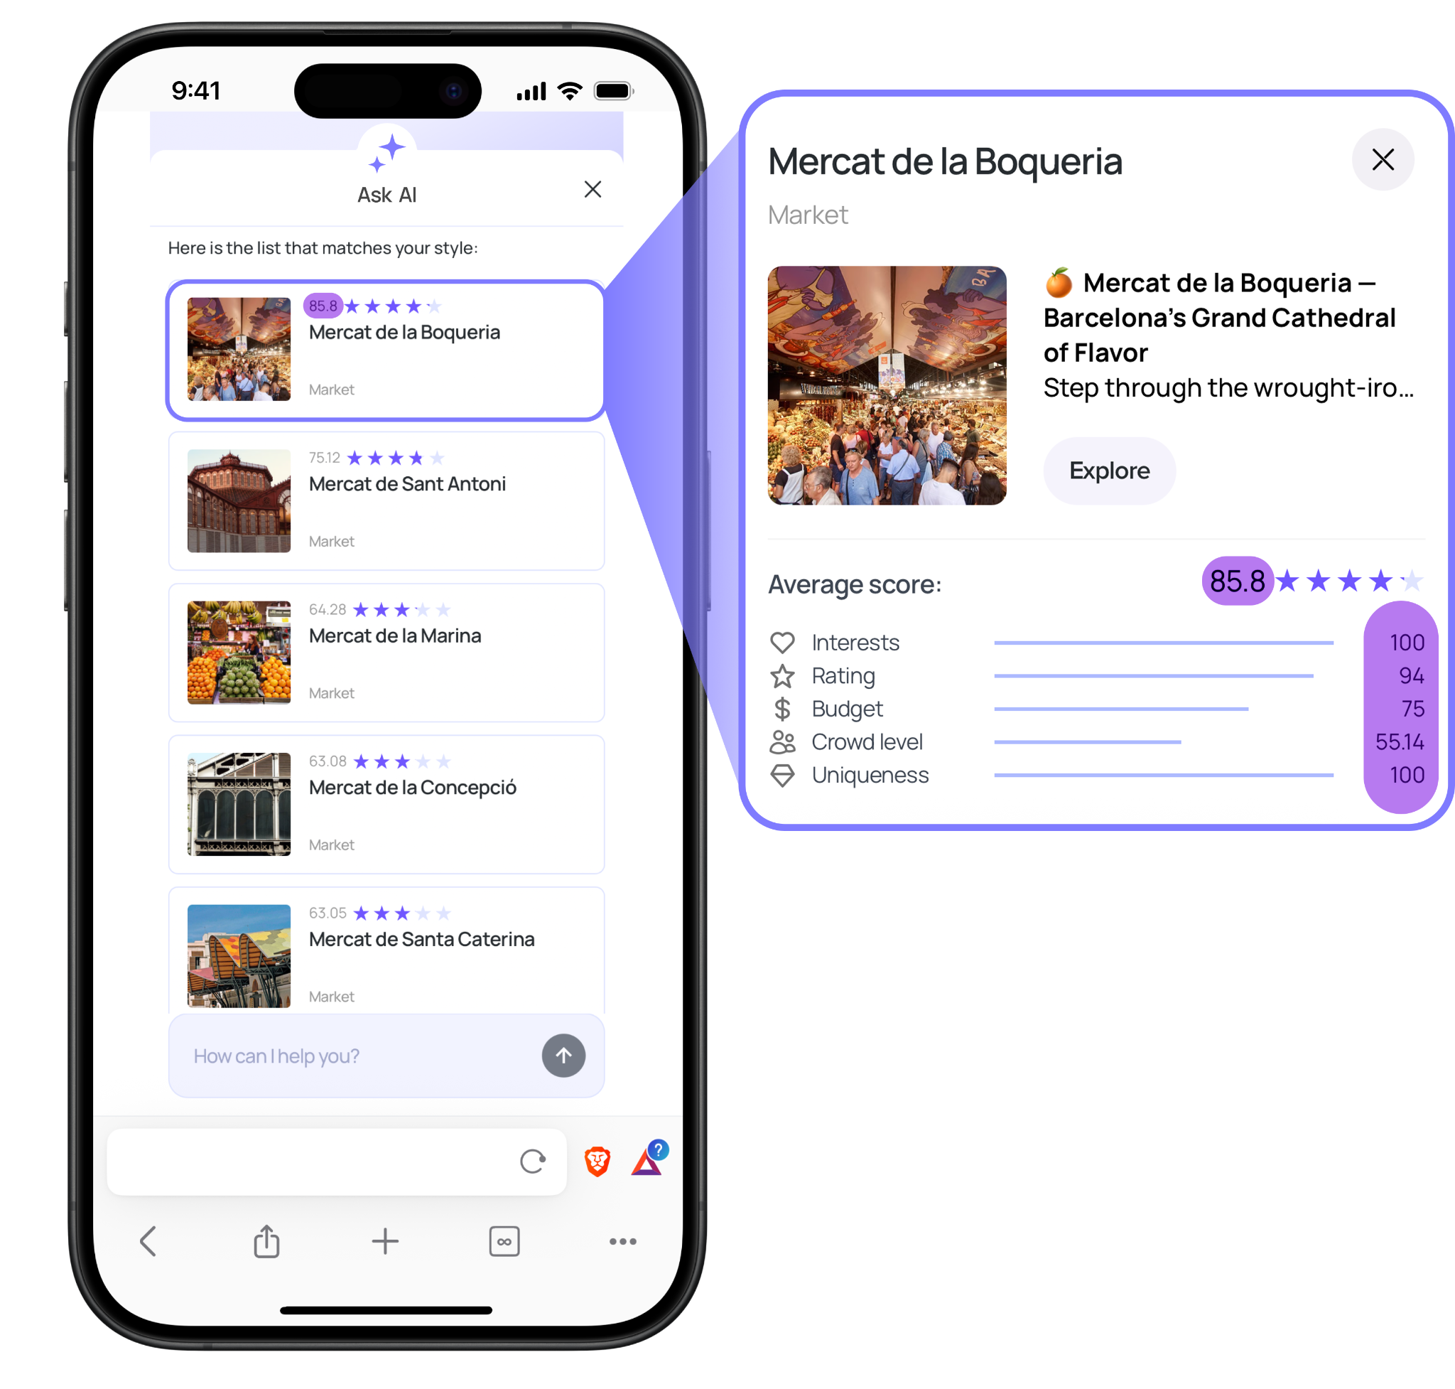
FLOW DISTRIBUTION EFFECTIVENESS
INPUT:
© TravelVerse Copyright. 2025

Slide 16
Thank you!
travelverse.live
travelverse@1worldonline.com

